Slide 1


Slide 2
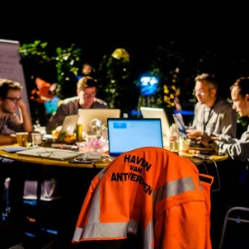
A 3-day event where students, professionals, start-ups & scale-ups tackle challenges within the maritime and logistics sector. During these 3 days, they go from idea to working concept, together with coaching of experts within the industry. Everybody is welcome to co-create the port of the future!
Hackathon
Marathon of ‘Hacking’

Slide 3

Get to know the atmosphere of the past edition
Logistics of the Future ‘16

Slide 4
Hackers’ agenda
Thursday 11/10/2018 – Saturday 13/10/2018
THURSDAY 11/10
FRIDAY 12/10
SATURDAY 13/10
Registration & dinner
17:30 – 19:00
Everybody is welcome
Hackers breakfast
08:00 – 09:00
Hackers breakfast
08:00 – 09:00
Last coaching sessions
09:00 – 11:30
Kick-off ChainPort Hackathon
19:00 – 19:45
Everybody is welcome
Continue hacking
09:00 – 12:00
Hackers lunch
12:00 – 13:00
Hackers lunch
11:30 – 12:30
Introduction challenges & pitching
19:45 – 21:30
Everybody is welcome
Continue hacking with coaching
13:00 – 18:00
Pre – selection pitches (top 5)
12:30 – 14:00
Coaching by experts
21:30 – 23:30
Dinner
18:00 – 19:30
Welcoming of guests & networking drink
14:30 – 15:30
Everybody is welcome
Hacking 24/7
23:30 – 08:00
Pitch coaching*
19:30 – 22:30
Closing ceremony
15:30 – 16:40
Everybody is welcome
ICONS
Hacking 24/7
22:30 – 08:00
Winners & awards ceremony
16:40 – 17:00
Everybody is welcome
Dinner & networking
17:00 – 19:00
Everybody is welcome
Coaches
Partners
*coach who helps the hackers for the preparation of their final pitch

Slide 5

Themes ChainPort Hackathon
6 challenges – ready to be solved!

Slide 6

Thema’s ChainPort Hackathon
6 challenges – klaar om opgelost te worden!

Slide 7
Challenge 1 – Mobility
Working on an efficient and sustainable modal shif

Slide 8
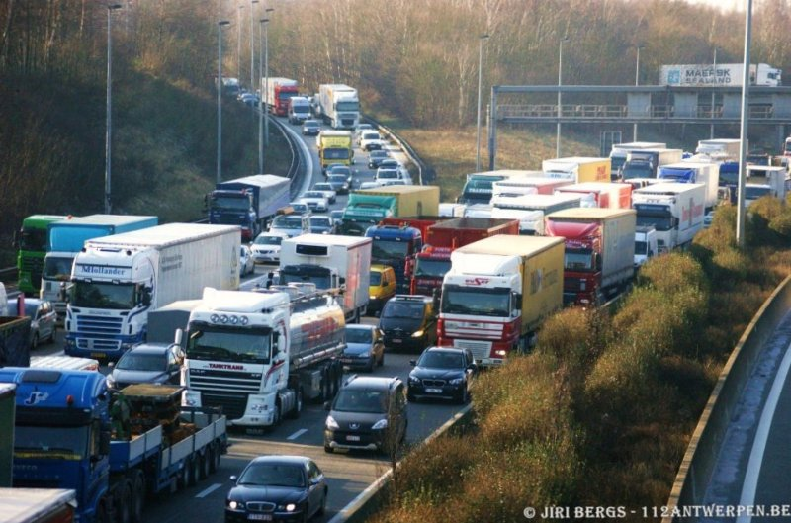
The challenge

Slide 9
The challenge– Modal split port

Slide 10
The challenge– Traffic on Antwerp Ring

Slide 11
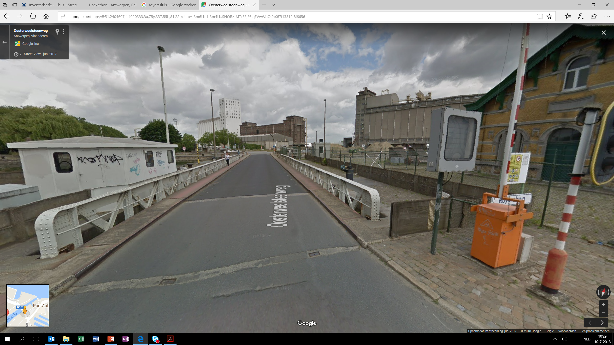
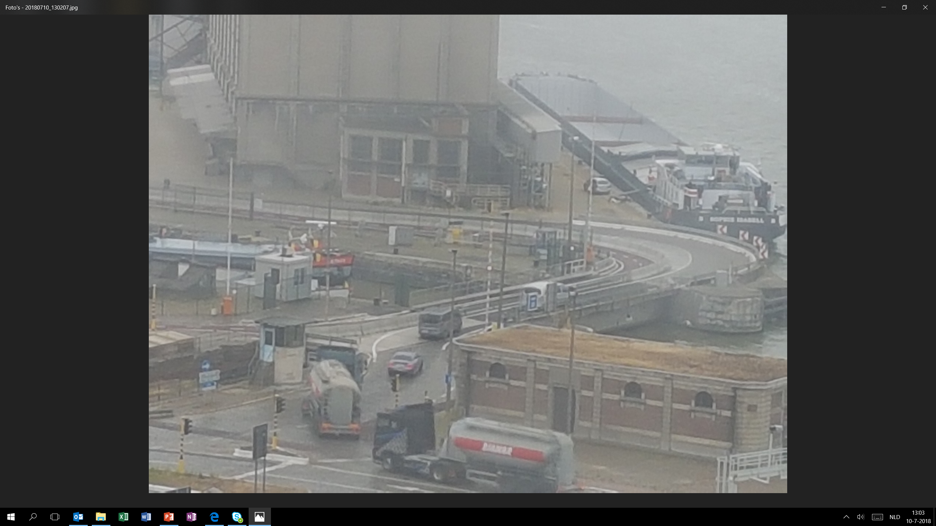
Infrastructure

Slide 12
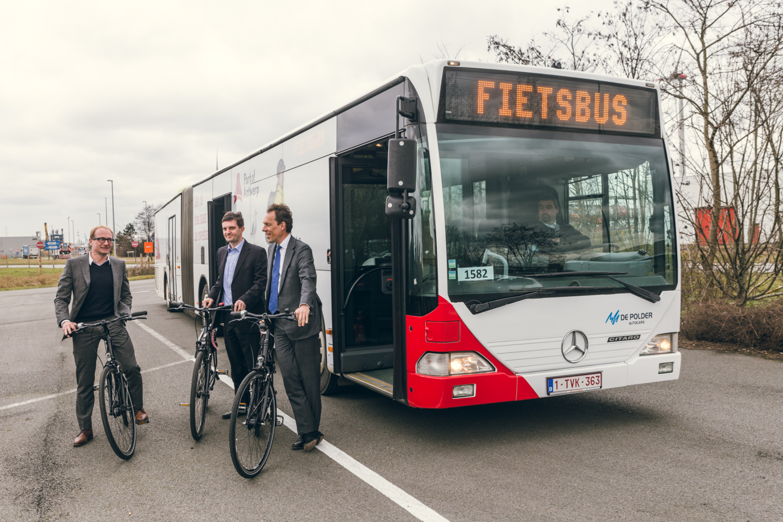
Alternatives – The bicycle bus

Slide 13
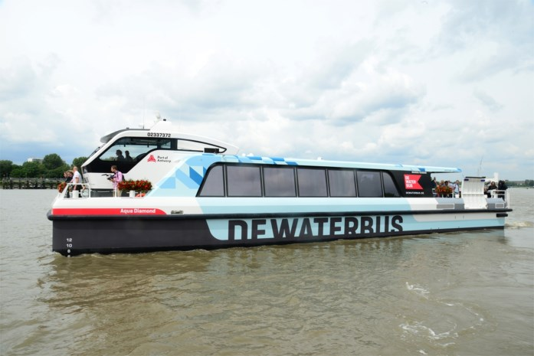
Alternatives – The Waterbus

Slide 14
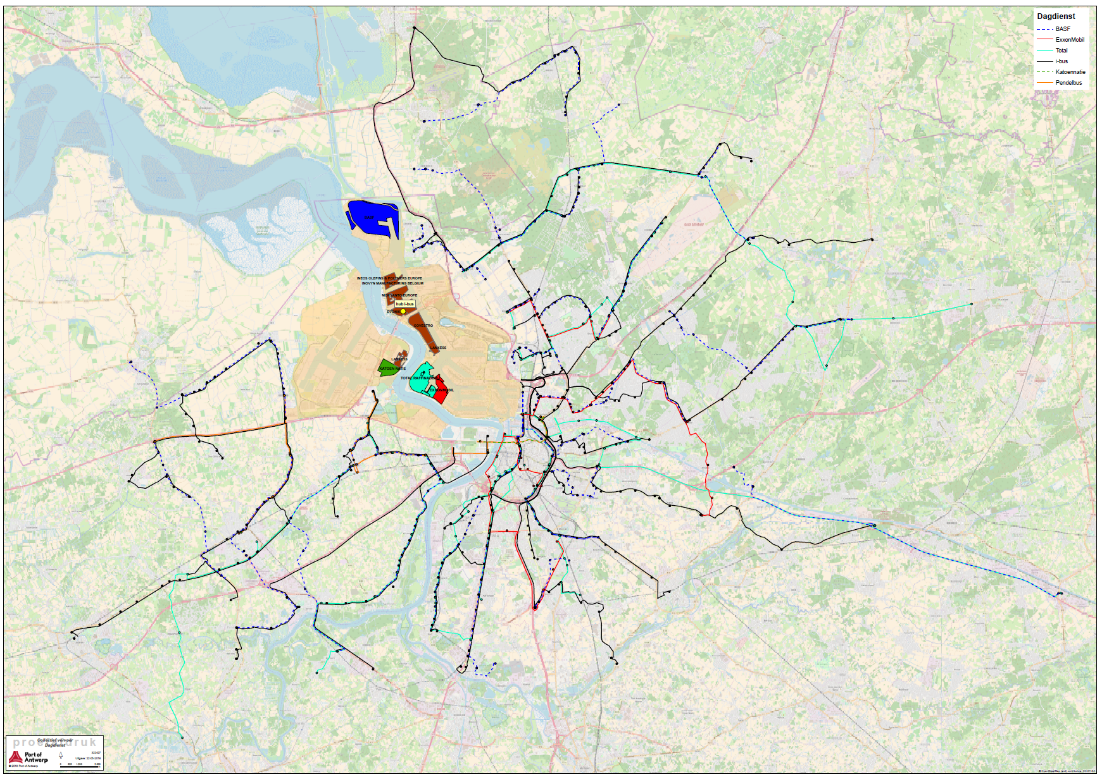
Alternatives – Collective transport

Slide 15
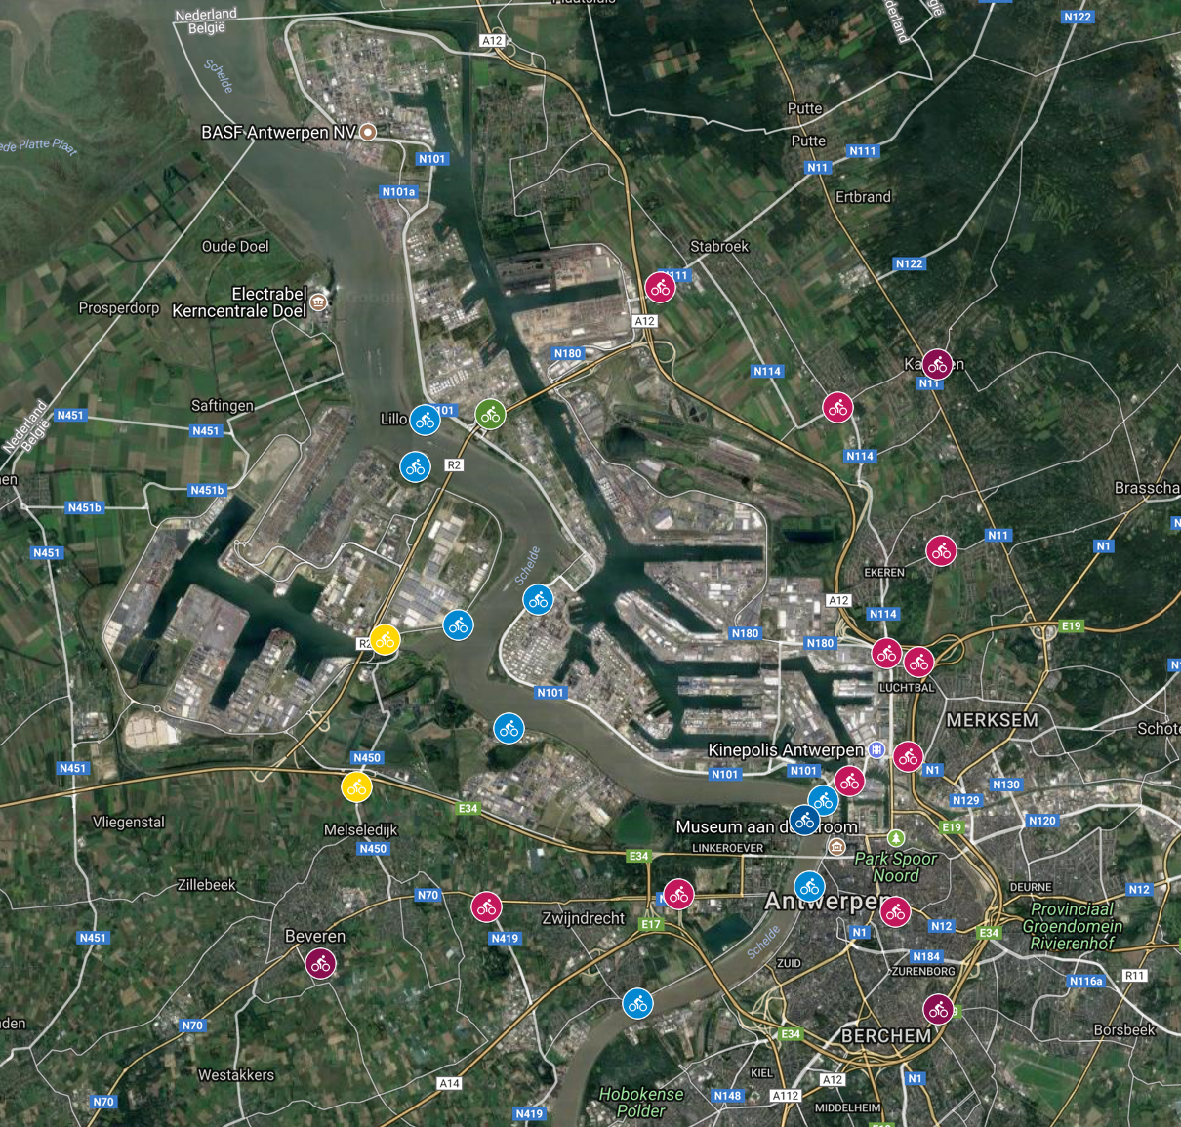
Alternatives – Electric bikes

Slide 16
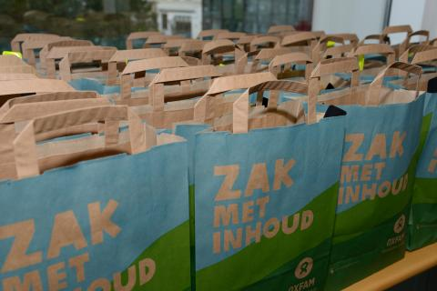
Mental shift

Slide 17
Challenge 2 – Inter Port:
Sharing of data between world ports
Data of a Port Community System (PCS) can generate added value for other PCS, and to align these, can develop new services. The exchange of information and data between ports is very important.
The current Maritime Single Window (MSW) collects and centralizes a lot of info for the European countries. Can this be used to create predicting analysis? Can it be combined with data from outside of the European Union?

Slide 18
Challenge 3 – Safety & security

Slide 19
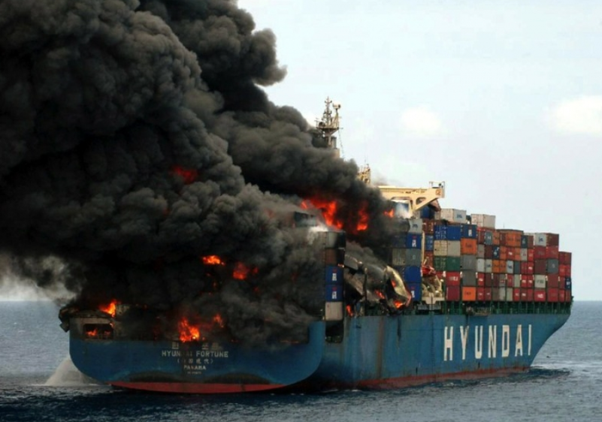
Introduction
The current documentation & processing of hazardous cargo has tremendous safety impact and comes with significant liabilities for all parties involved
Goal = To improve the process:
Complications:
DG (dangerous goods) form inconsistency
Manual processing
Interpreting incomplete information

Slide 20
Context
There is a pressing need in the sector for a common solution for DG input. Currently there are no standardized ways to declare DG cargo:
Wide array of different system interpretation
Various DGD formats
Current “work-around”:
Human interaction and interpretation
Which results in:
Wrong assumptions
Immense implications regarding the safety
Different parties involved face increased liability and responsibilities
Time-consuming process

Slide 21
Shippers
Currently no convenient way to process all relevant DG data
No live checks with for example international & national law
Re-entering data manually in the system
Consequently:
Responsibility shift
Increased waiting times for booking confirmations and for delivery on terminal
Safety implications

Slide 22
Shipping Lines/Carriers
The received DG information from the shipper is fragmented and sometimes inadequate or inaccurate.
Re-entering data manually in the system
Interpret missing information due to:
Various formats of DGD (PDF, Excel, Word, JPEG,…)
Inadequate systems
Consequently
Increased liability
Safety implications

Slide 23
Terminals
Inadequate or even inaccurate DG data.
Consequently
Segregation issues
Safety implications
Discrepancies in regard to placards

Slide 24
Port Authorities
Local port authorities face the problem of missing, inaccurate or double declarations by shipper, Shipping lines and carriers.
Wrong arrival dates/times
Wrong vessels
…

Slide 25











Transport → Port Information: Dangerous Goods Notification in APICS
APICS-loket Vessel Information
Shipping Agent
APICS2
Forwarder
1
IFTDGN / APICS-loket
Dangerous goods notification
Harbour Master’s Office
EDI: COARRI – loading report or e-mail :daily DG inventory
EDI: CODECO –GATE IN or e-mail : daily DG inventory
2
3
Terminal operator
Terminal operator
Terminal
1
Transporter
2
3
4
≥ 24 hrs prior to arrival on terminal
Arrival on terminal
Loaded on sea going vessel
Departure sea going vessel
Notes:
The information provided by the different stakeholders in regard of the handling of dangerous goods by means of EDI, is processed by APICS2 (Antwerp Port Information and Control System)
The example in this slide shows the flow of information for the export scenario.
Dangerous goods notifications have to be sent 24 hours prior to arrival/handling on terminal. (notfication contains: detailed cargo information, location of handling, means of transport, ETA)
 Dangerous cargo arrives at the terminal: ATA is reported by the terminal. (EDI : CODECO: Gate In message)
 Dangerous is loaded on a sea going vessel: ATD is reported by the terminal (EDI: COARRI: Loading report)
When the vessel leaves the port, the Harbour Master’s Office knows what dangerous cargo is on board of the vessel.
EDI: Electronic Data Interchange
IFTDGN: International Forwarding and Transport Dangerous Goods Notification
CODECO: Container Gate In/Gate Out/Logistic Move Report
COARRI: Container discharge/loading report

Slide 26

Role of the HMO as LCA for Safe Sea Net
Business as usual
In case of emergency
Antwerp (BE)
1. Vessel Voyage Info DG details
BELGIAN (NCA) SAFE SEA BEL
Port of Antwerp – HMO (LCA)
MRCC Ostend (BE)
3. Vessel Voyage Info & DG details
2. Vessel Voyage Info DG on board (Y/N) & details available
2. DG details ?
NCA EU-MEMBER STATE
1. Vessel Voyage Info DG details available?
EU-EMSA SAFE SEA NET
Lisbon (PT)
4. Vessel Voyage Info & DG details
Automated system: request / repsonse time: 12s for a containership (12s = response time in test for ESTELLE MAERSK / L: 397,71m / 15550 TEU = time between step 2 and 3 in case of emergency) MRCC: Maritime Rescue and Cordination Centre – EMSA : European Maritime Safety Agency NCA: National Competent Authority LCA: Local Competent Authority – HMO : Harbour Master’s Office
Notes:
In the translation of EU Dir. 2002/59 – in Belgian legislation
The Flemish autorities are apointed as the NCA (National Competent Authority), the HMO is apointed as the Local Competent Authority (LCA) in Antwerp.
This Directive is made to guarantee that for all vessels in European waters, its exact position and destination is known and also the information on the dangerous and polluting goods on board.
The cargo information is collected in the port by the HMO in its role as LCA.
For all vessels leaving the port, the HMO can in case of emergency, provide emergency response authorities in all EU-Members States with the necessary DG information to help them in planning and executing their actions.
All communication is fully automated and goes over the European platform called “Safe Sea Net” based in Lisbon (PT) where all member states are connected.
How does it work?
The NCAs communicate with SafeSeaNet via XML messages. The communication between the NCA and the LCAs also uses XML messages over the Central Broker System (CBS). The Port Authority sends all necessary itinerary and hazardous cargo information over the CBS according to the requirements of the SSN of every member state .
In addition to general vessel and itinerary information, the LCA specifies which vessels have hazardous cargo. In case of an incident the SSN sends an electronic request for detailed information. APICS replies automatically with a detailed overview of all cargo information, including the stowage positions. The ship’s agent/forwarder's IFTDGN declarations are used for this. Missing stowage positions can be supplemented by information provided by the Terminal operators in APICS. (Source APCS website)
This slide gives a schematic of the operation of the Safe Sea Net and the role of the HMO as LCA.
To make it possible for the HMO to take this responsibility as LCA, Port regulations are in place to make sure that all information is available in the Port information system (APICS) to start up the communication when necessary.

Slide 27
Challenge
(1) Data quality
Technologies could be used to check whether the information which arrives at the port authorities still matches the data as provided by the shipper. Provisional versus final.
(2) Booking process
Shipping line/carrier neutral
Optical recognition (OR) of the various DGD documents
Live checks of dangerous cargo details against vessel/carrier and port restrictions, international and national regulation
Accessibility to dangerous cargo details at all times for all involved
Possible EDI interconnectivity for all parties involved
Automatic declarations to port authorities
Data in the system is updated by port and terminal info (CODECO and COARRI)

Slide 28
DATA
For this challenge we are looking to combine various data sources:
Initial input by shipper (OR): DGD in various formats
Shipping line/carrier information: DGD in EDIFACT/XML format
Terminal data
Port Authority Data
Database with DG restriction rules

Slide 29
Challenge 4 – Process & document flow:
Digitalisation en document processing

Slide 30


Drugs
Dirty Bombs
Terrorism
Increasing trade & data volumes
Contraband
Dual use goods
Chemical Biological Radiological Nuclear Explosive materials - threats
E-commerce

Slide 31
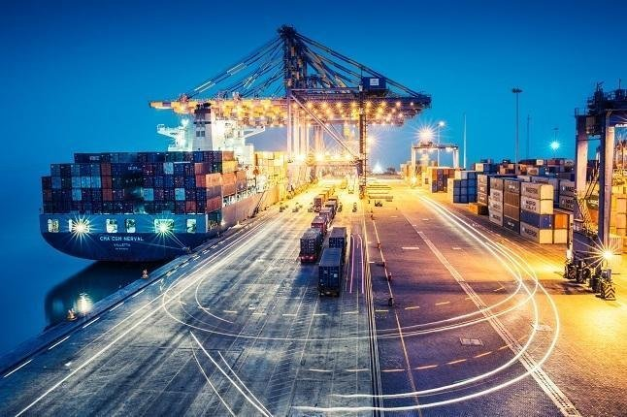
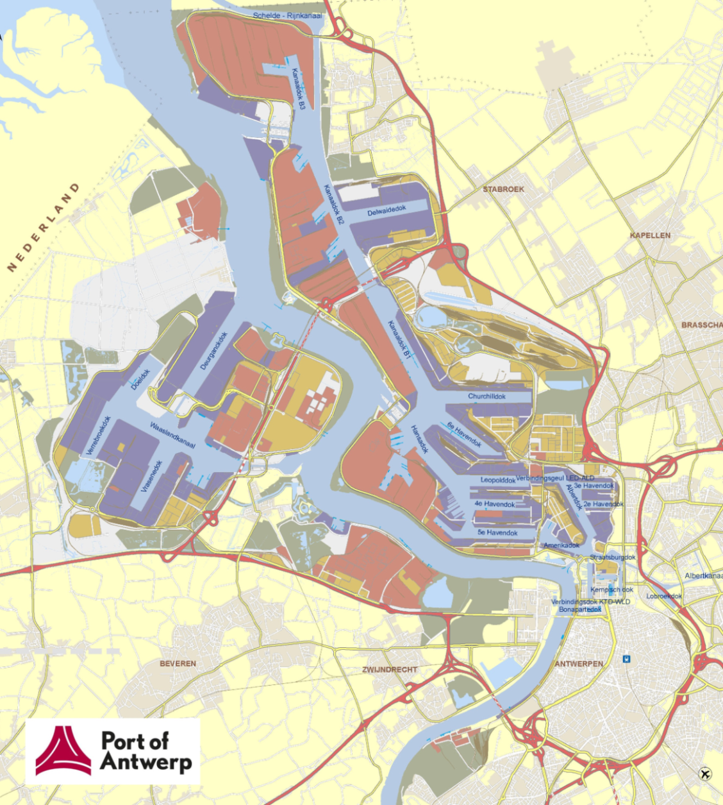
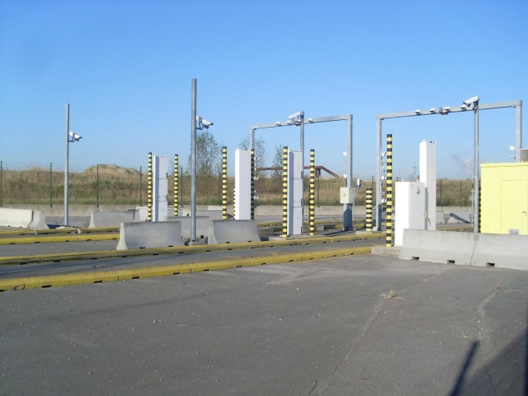
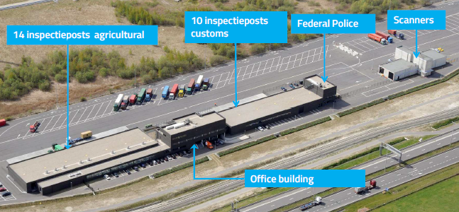
Port of Antwerp
100% Already in place – NUCLEAR SECURITY
Goods are brought to customs infrastructure

Slide 32

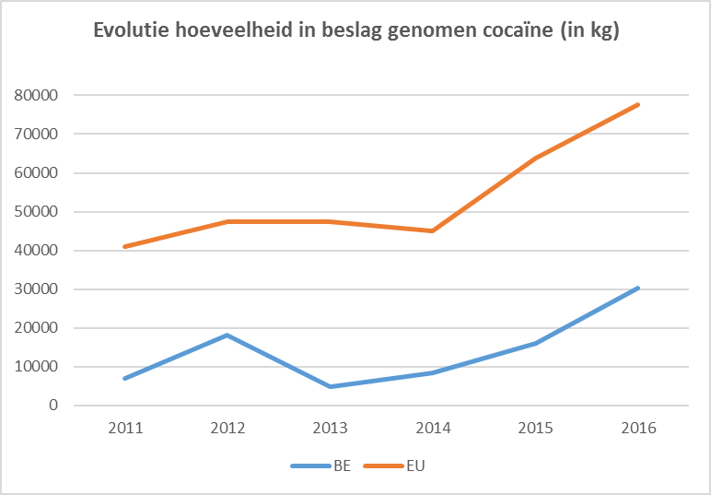
THE PROBLEM – COCAINE CATCHES
The rise of the dark side of the force
Evolution of the quantity of seized cocaine (in KG)
2016
BE: 30 tons
EU: 77 tons
2017
BE: 42 tons
2018 to date
BE: +20.5 tons
39,05 %
38,21 %
24,95 %
16,82 %
10,04 %
18,53 %

Slide 33
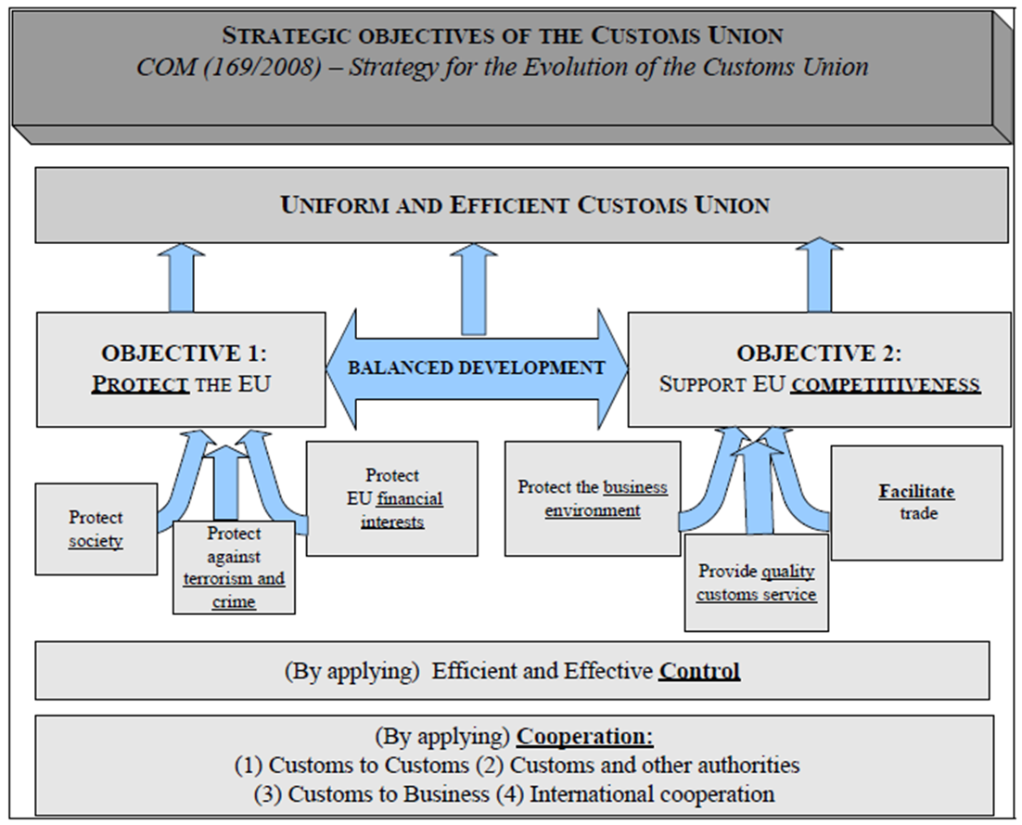
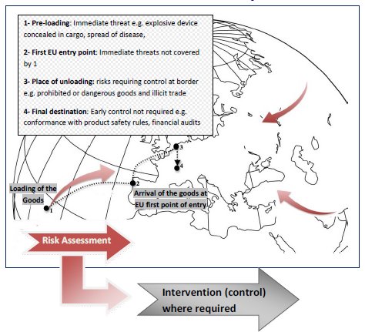
FUTURE VISION
Our strategic goals and approach
Protect EU & Facilitate legal trade
Multi-stop defence shield
Introduction of high-tech means of controls at the EU external border
for IMPORT & EXPORT

Slide 34

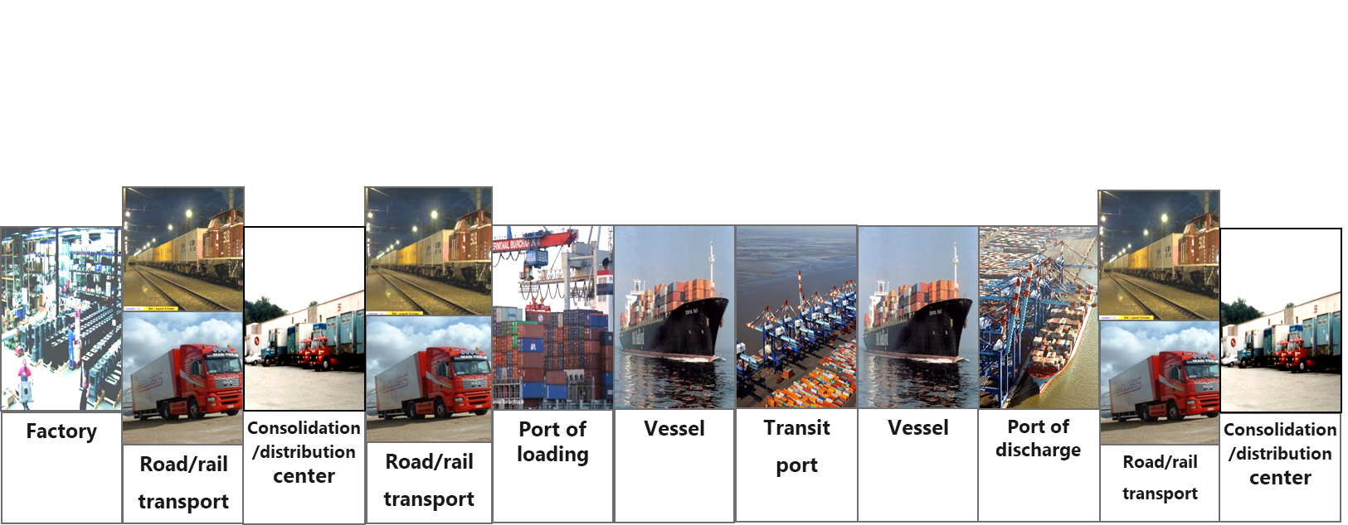
FUTURE VISION Our strategic goals and approach
Monitoring & controlling the entire supply chain

Slide 35

FUTURE VISION Maximum security & facilitation Through technology
1. Facilitation of the legal trade by no/minimal delay
Minimum intervention strategy for inspection
2. Maximum security by 100% scanning/screening
100% digital & artificial intelligence!
3. Maximal use of high-technology control means
Full screening integrated multi-mode inspection technology with automated stop-function

Slide 36


TECHNOLOGICAL CHALLENGES
More efficient non-intrusive inspection technology
High protection against radioactive radiation
Integrated in the logistics flow
100% scanning & digital
Multi-mode / Omni-view = transmission, backscatter, MPI, 3D,… & imaging software as a support for the verification of the goods
High performance systems & Low processing time
100% Reliable = no false positives & no false negatives
Artificial Intelligence
Full smart-scan / smart Blockchain
Artificial intelligence = link with big data (goods declaration,…, certificates, authorizations) and automated stop-function

Slide 37
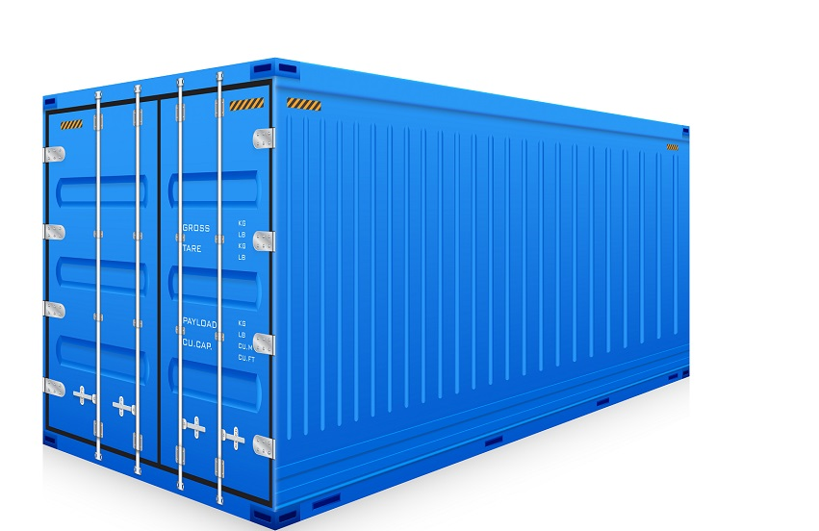
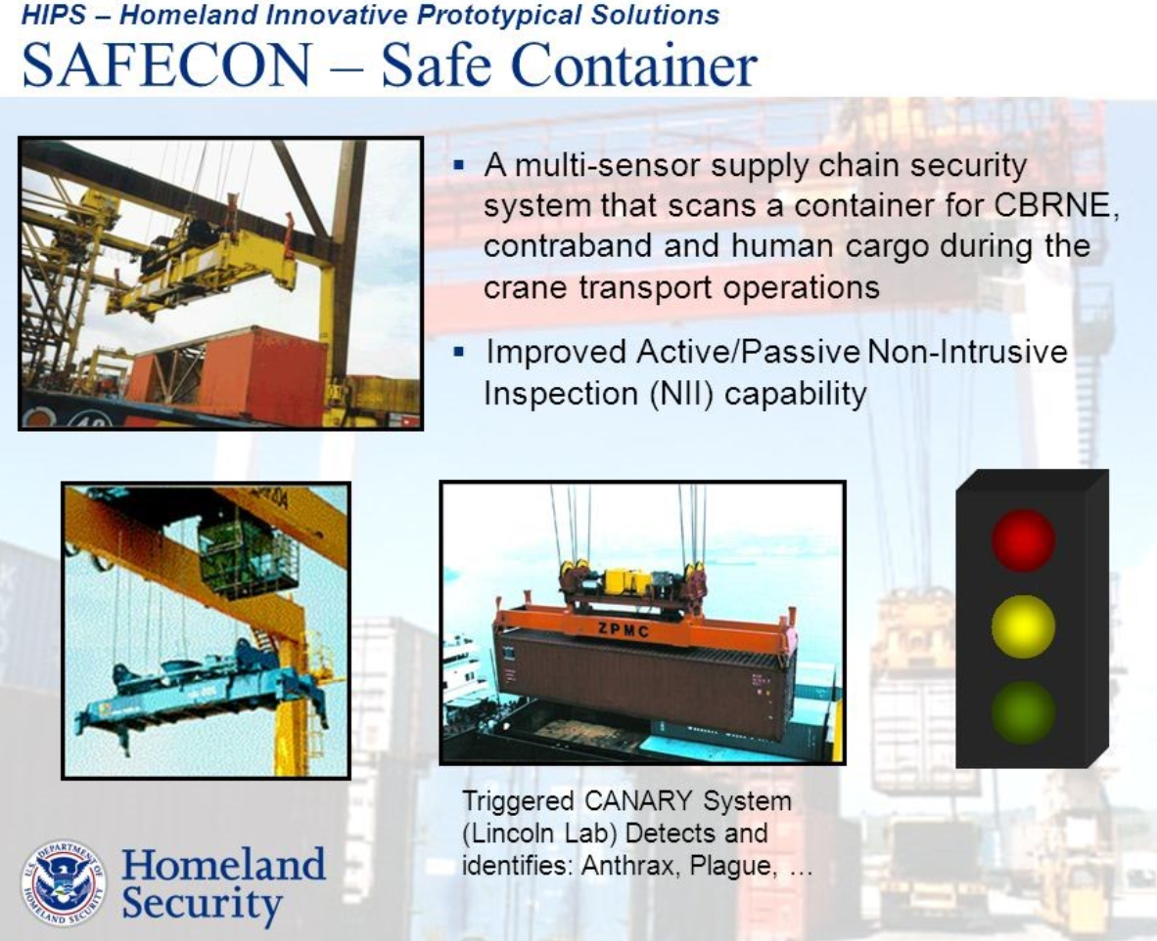
TECHNOLOGICAL CHALLENGES
Scanning on terminal

Slide 38
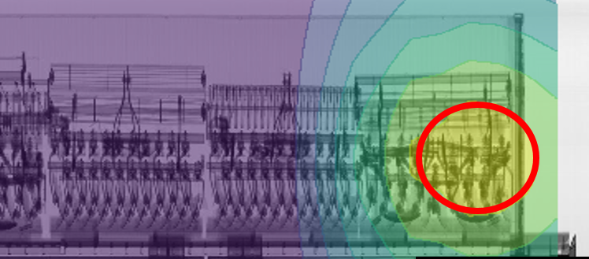
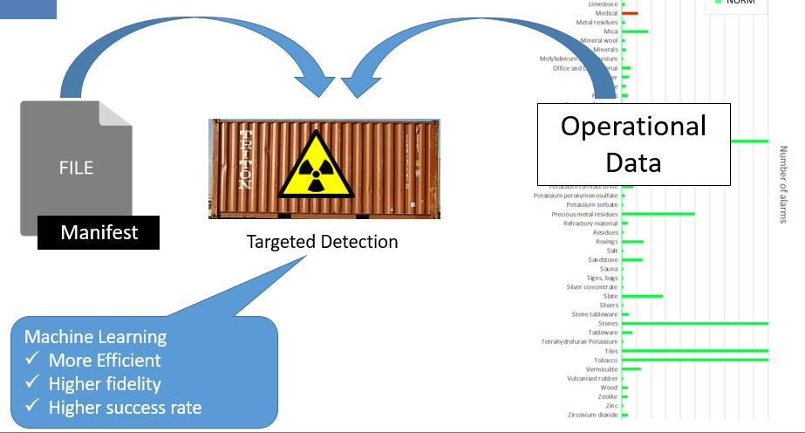

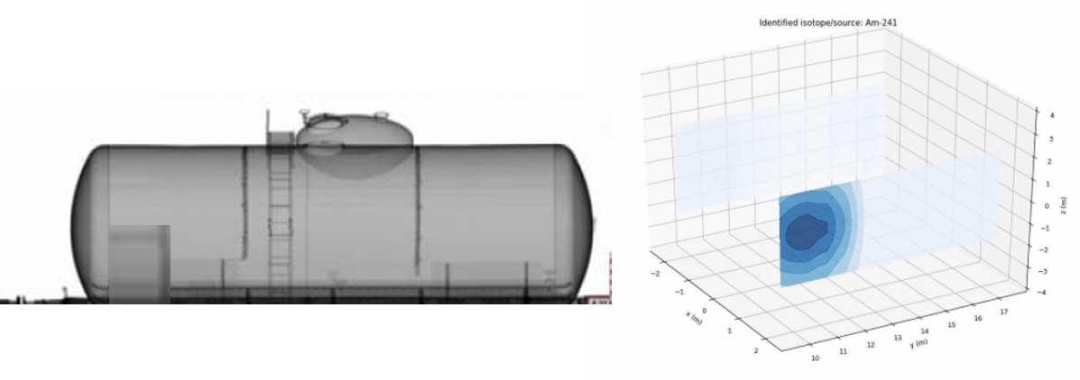
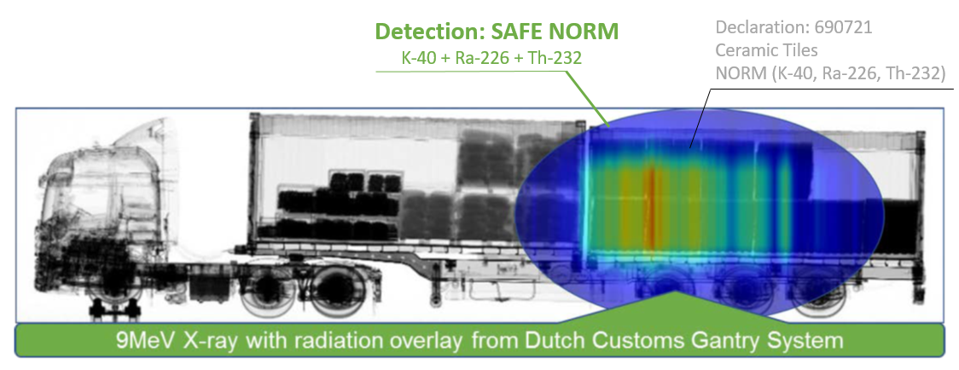
TECHNOLOGICAL CHALLENGES
Artificial intelligence on top of our Data
Multi-mode / Omni-view = transmission, backscatter, MPI, 3D,… & imaging software also as a support for the verification of the goods

Slide 39
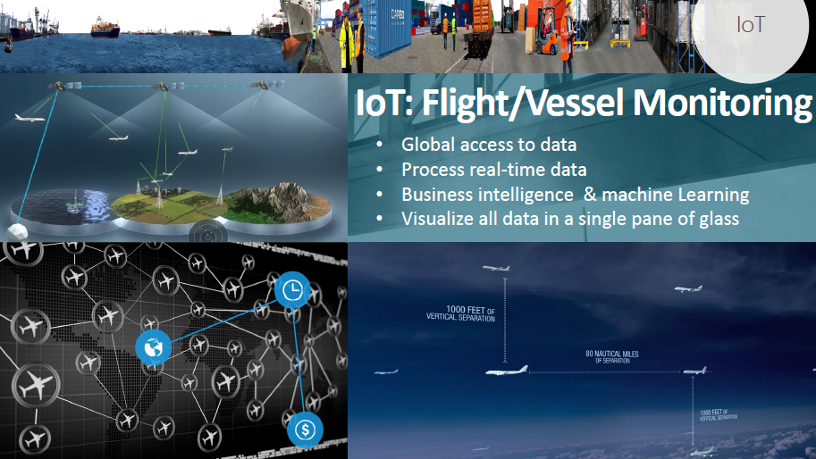
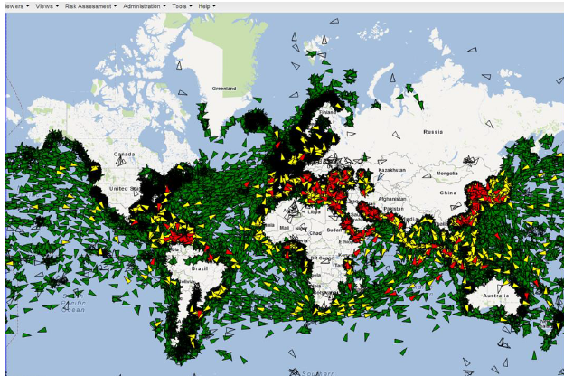
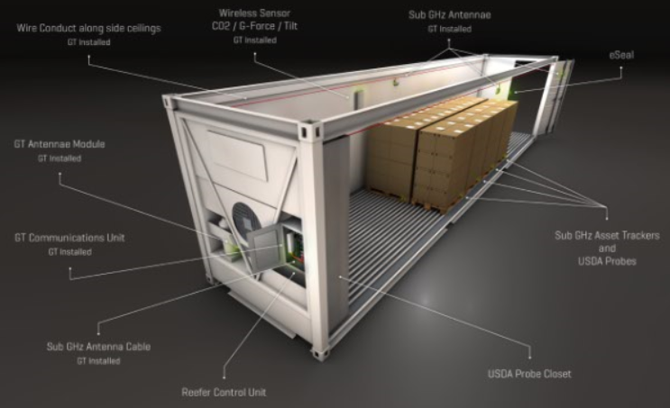
TECHNOLOGICAL CHALLENGES
Smart container trade

Slide 40
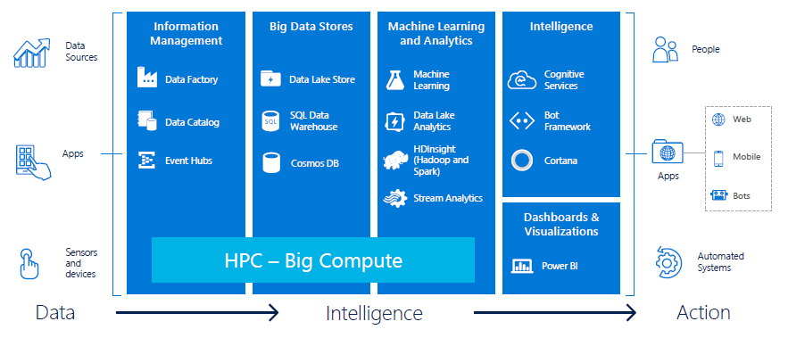
TECHNOLOGICAL CHALLENGES
Operating with huge volumes
Turn data into intelligent action

Slide 41
Challenge 5 – Sustainability:
Data as an extra energy source for the future

Slide 42
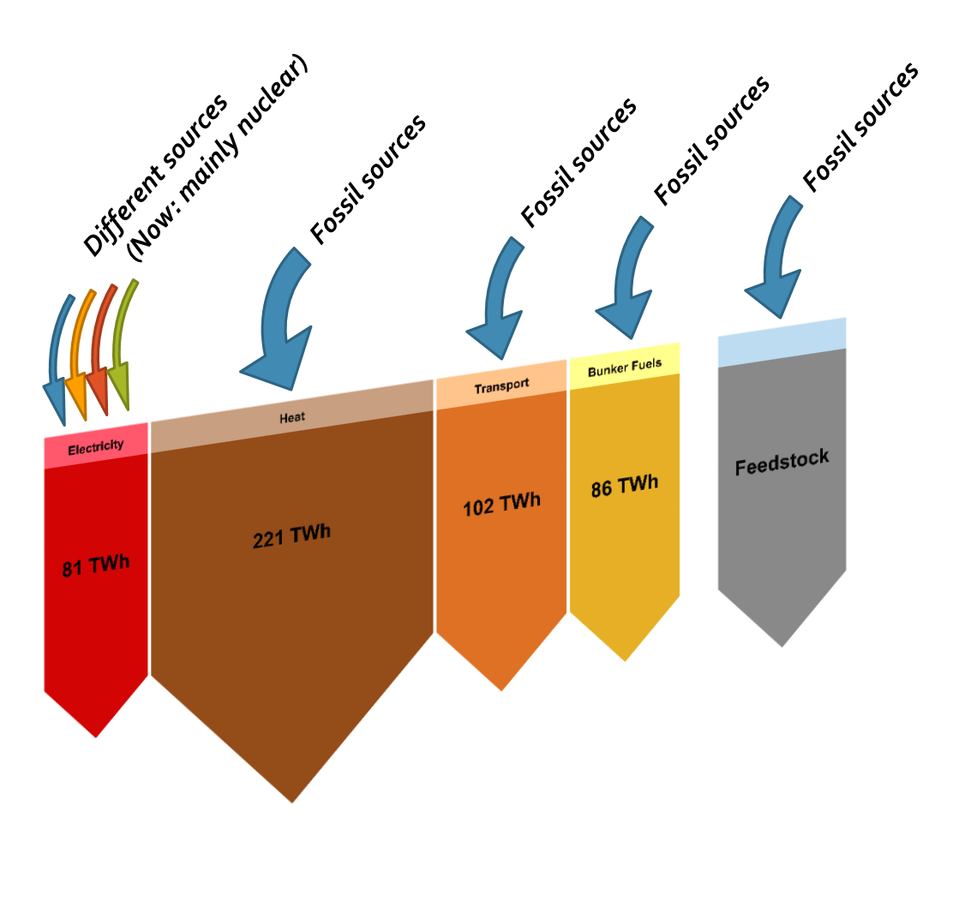
Context: “Road to a decarbonized world”
Current situation: Big focus on introducing renewables in the electricity production sector
Widespread public knowledge and political support schemes
Straight forward technical solutions already available But: Electricity only (small) part of total energy consumption
Question: Do we need to push focus to other sectors?
Large energy consumption in other sectors
Currently almost exclusively use of fossil sources to meet energy demand
Introduction of renewable energy sources is not common yet, technology not yet competitive?
Solution? Port of Antwerp is a hub where all sectors come together
If we create links between different sectors, can this be part of the solution (examples are electrical vehicles, Power-to-molecules installations, CHP’s,…)
How relevant is the local potential for energy production in a port environment (with huge imported energy flows)
Energy consumption in Belgium (2015) per sector

Slide 43
The challenge
How to ‘greenify’ different energy sectors in a port environment?
Find synergies between sectors to enlarge potential advantages.
What are the positive effects of electrifying the transport, heat and/or chemical sector. What is the potential positive effect on the environment? What is their effect on the electrical grid?

Slide 44
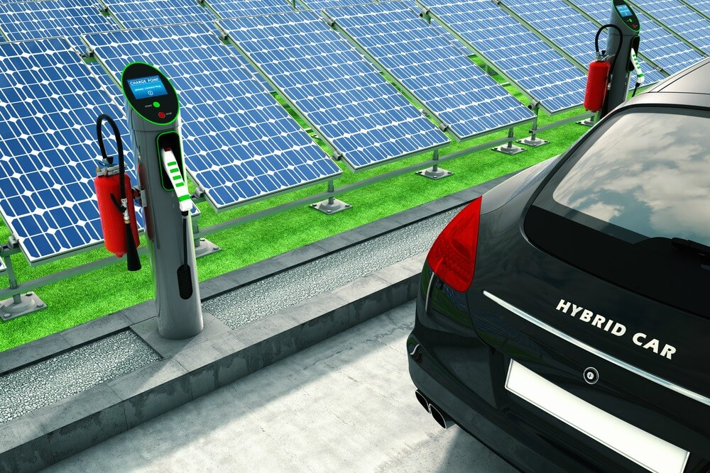
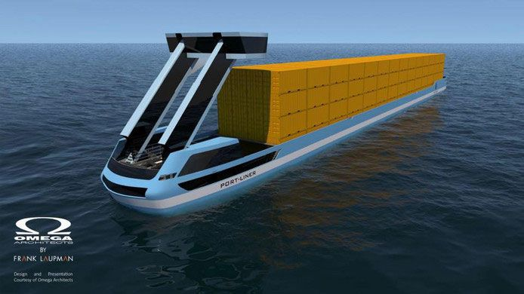
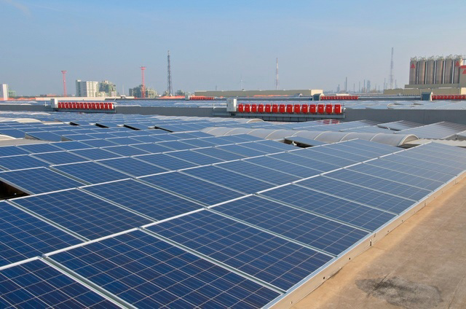
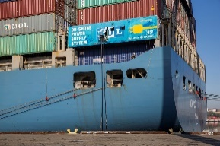
Example 1: Electric applications in transport to incorporate variable renewable energy
Problem
Air pollution and CO₂ emissions due burning of fossil fuels in internal combustion engines in transport applications
Distributed energy production puts a burden on the electricity grid (capacity transformers, voltage on grid,…)
Integrated solution?
Can battery electric vehicles solve the problem of the non-synchronicity between renewable production and transport services?
Can battery electric vehicles avoid the need for additional investments on grid infrastructure due compensating during overloads? Thus balancing out the local grid?
What does 200 MW of PV mean for the transport sector? How many employees in the port can drive on the energy produced? What could be the possible effect for air quality?
Additional applications?
Shore power with battery capacity
Charging of inland barges (or smaller short sea vessels)
Forklifts, cranes, trucking,…?

Slide 45
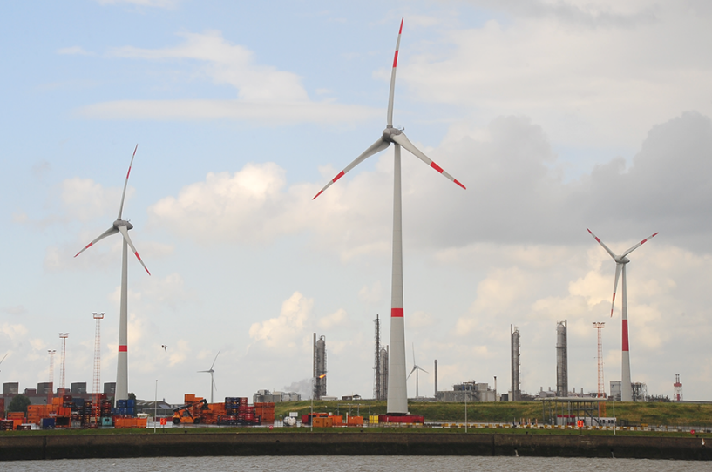
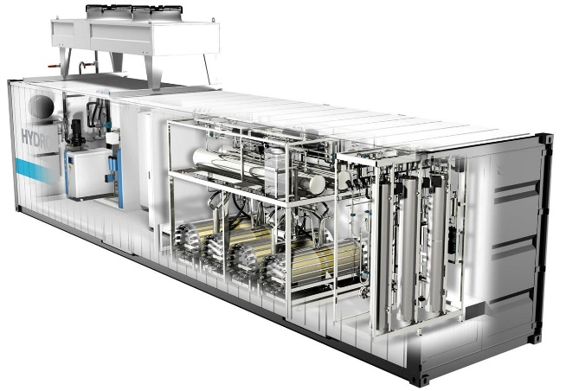
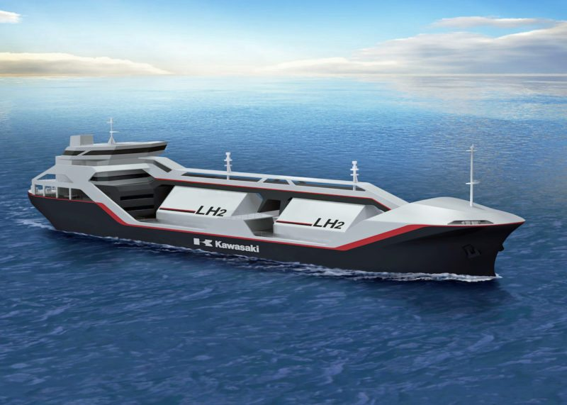
Example 2: From power to fuels and/or chemical feedstock
Problem
How to make the shipping sector and the chemical industry less dependent on fossil sources?
Integrated solution?
Production of hydrogen on site (from wind turbines) for small niche applications to stabilise the local grid
Import of hydrogen produced by cheap renewable energy cross-ocean to produce base products for the chemistry sector
Additional questions?
By 2020, 250MW installed wind capacity is expected in the port of Antwerp. Is there a over-capacity expected? Which niche-markets can be filled up by this green energy? How much hydrogen is realistic to be imported? How much hydrogen is needed to make the industry more sustainable

Slide 46
Challenge 6 – Education through gamification
Challenge: Improve the image of the port industry to attract more students and professionals.
Challenge: Apply serious gaming to improve work processes within the port of Antwerp
Teaser: https://www.youtube.com/watch?v=RsMnN-WSObQ

Slide 47
Prizes
Winning team: cash prize of 5000€
Ticket to the Internet of Things Postgraduate of Antwerp University
Work space for 3 months in The Beacon (Antwerp)
Access to the acceleration track of Voka-Alfaport
Coaching & mentoring from industry experts
Co-envision session with Nxtport
Possibility to set up a POC for the Port of Antwerp

Slide 48
Practical
Participation is free, 25€ no-show fee
Free food & drinks
Possible to sleep over & shower (50 spots available)
Everything is provided for you, just bring your laptop and some good ideas! ☺

Slide 49




Ready to participate? Register via www.chainporthack.com/antwerp

